Slide 1
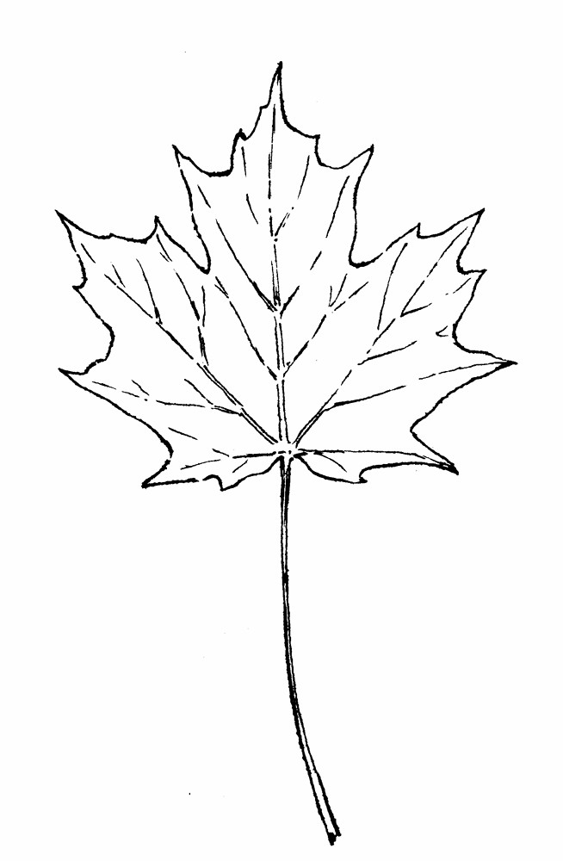



Extracting phenology and life history data from digitized specimens
Alexis Garretson
Department of Biology, George Mason University
alexis@garretson.net | www.alexisgarretson.com

Slide 2
Applying Citizen Science Protocols to Digitzed Museum Specimens Enables Data Integration and Discovery

Slide 3
Why citizen science protocols?
Citizen science data is often spatially extensive, but temporal limited
Herbarium-derived data products can be difficult to validate
Citizen science protocols often rely only on visual information

Slide 4
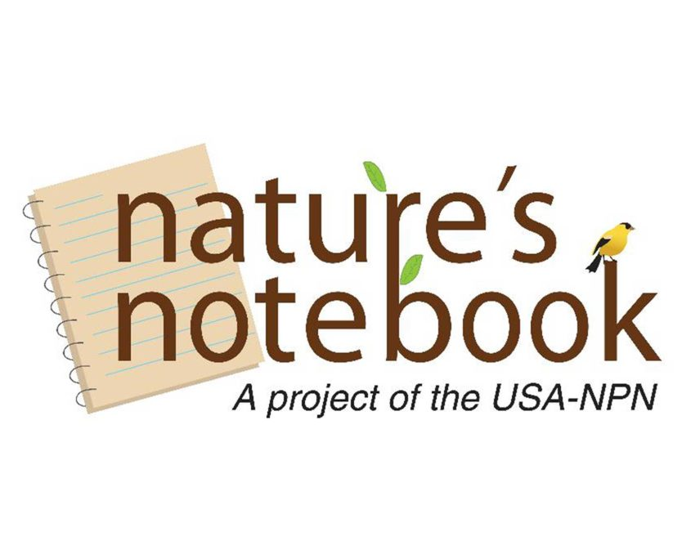

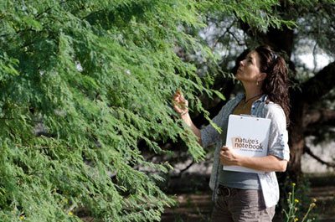
National Phenology Network

Slide 5
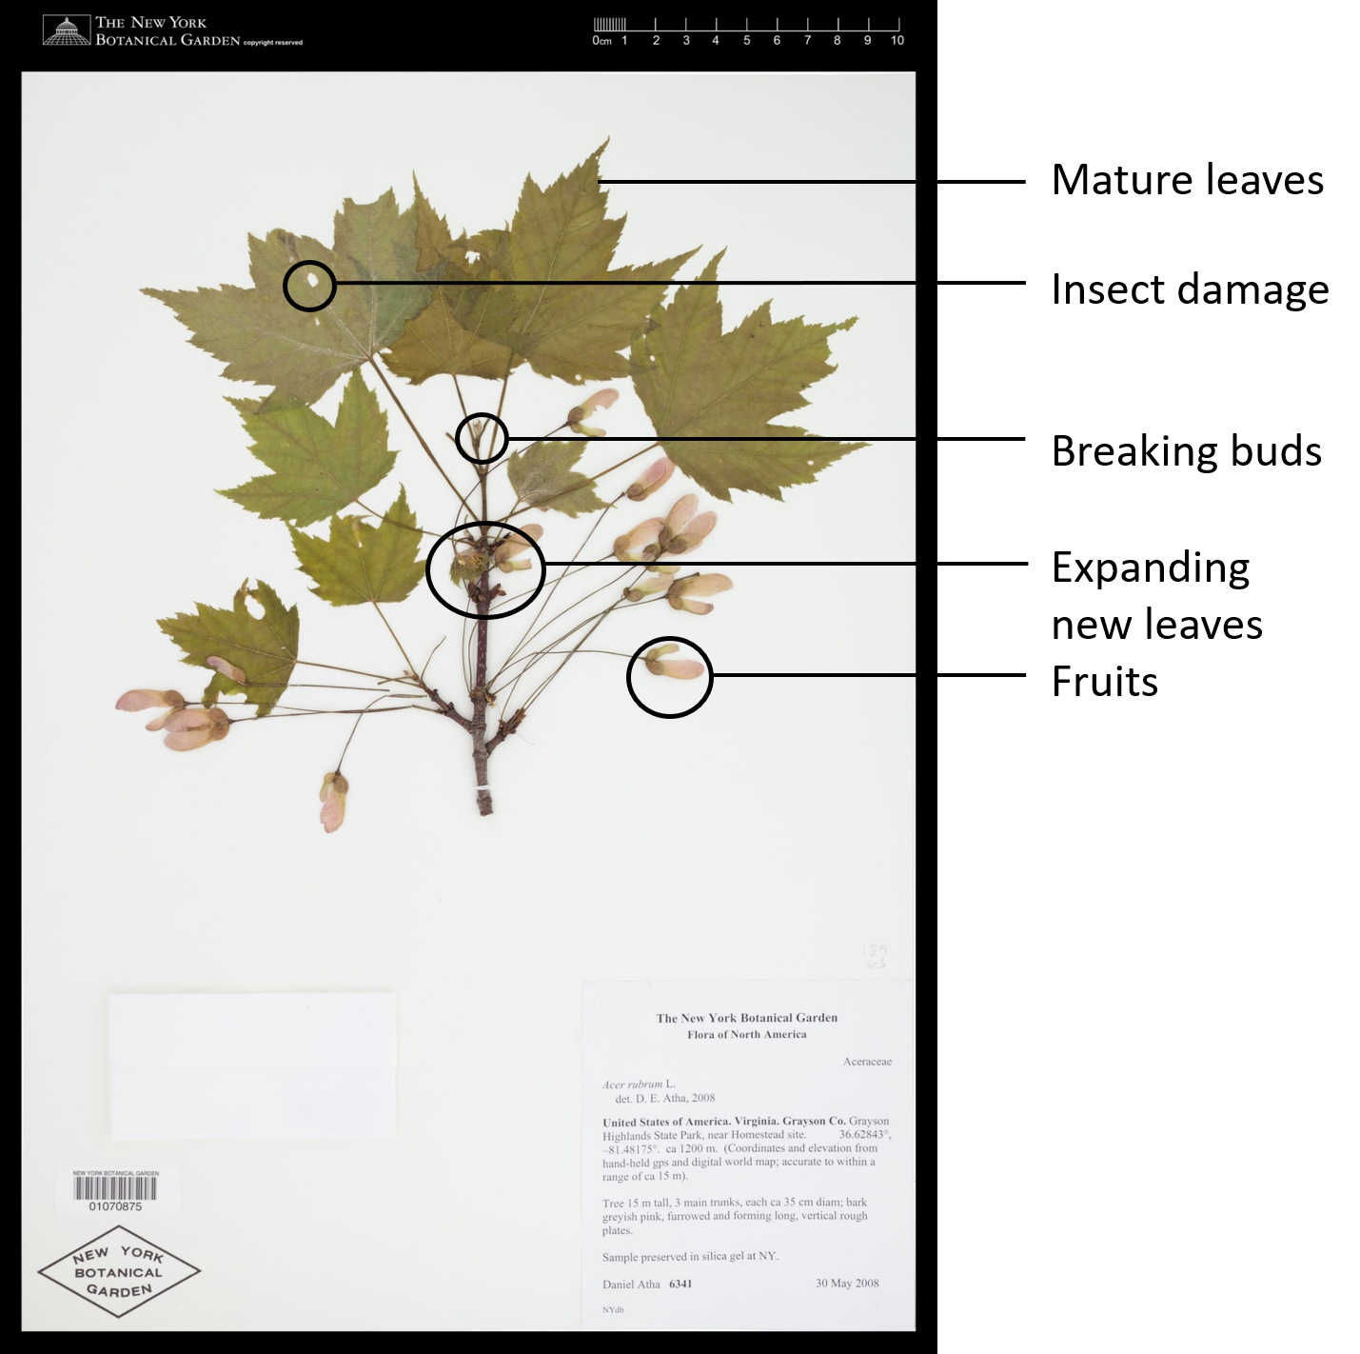
Leaves
Leaf buds
Breaking leaf buds
Increasing leaf size
Colored Leaves
Flowers or Flower buds
Fruit or seeds
Ripe fruit

Slide 6
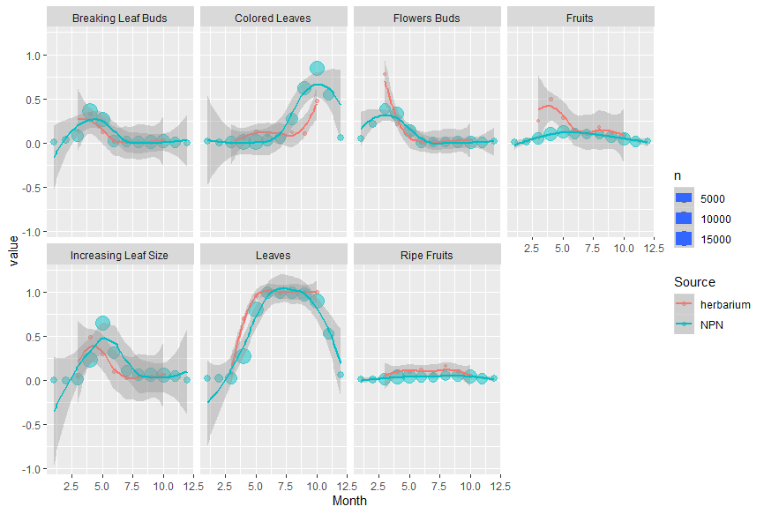

Slide 7
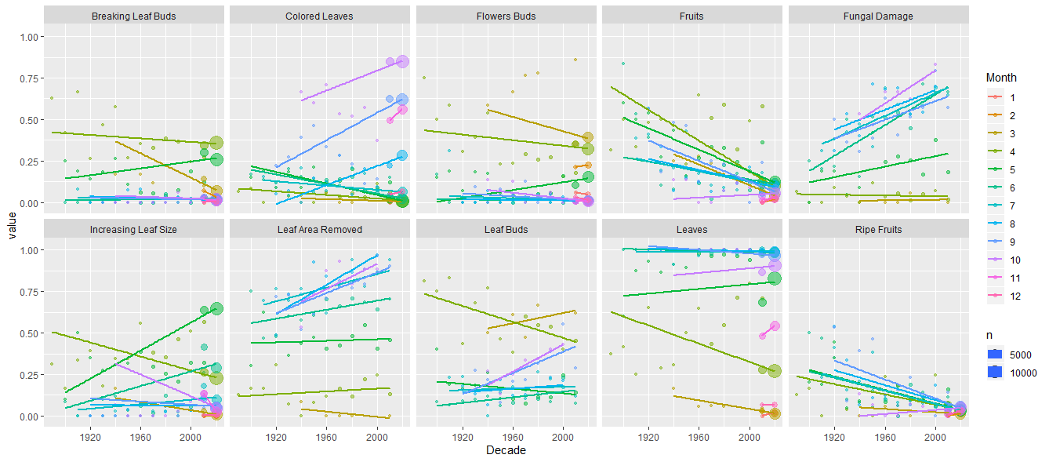
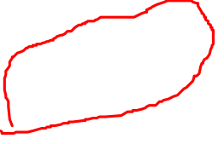

Slide 8
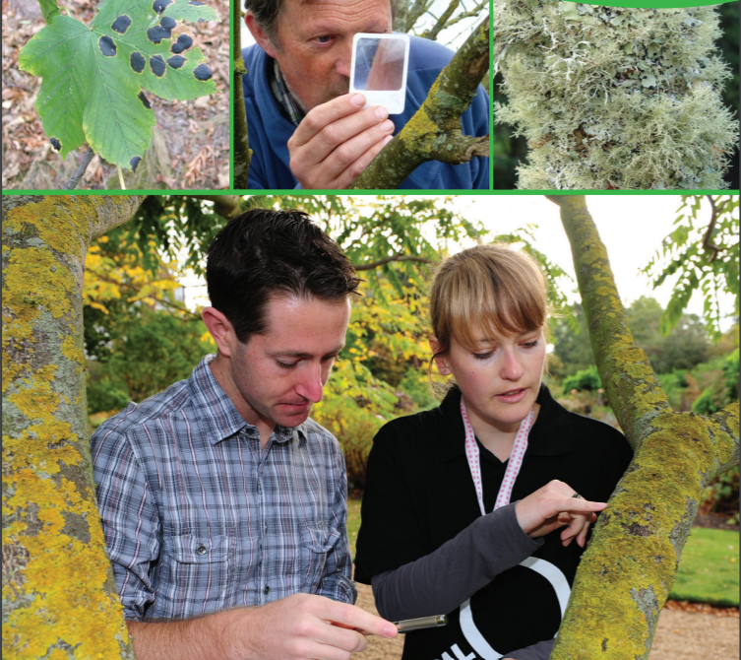

OPAL Air Quality Survey
OPAL Air Quality Survey

Slide 9
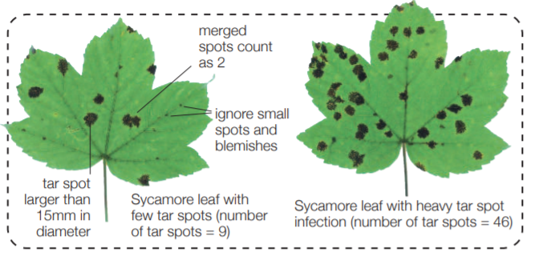
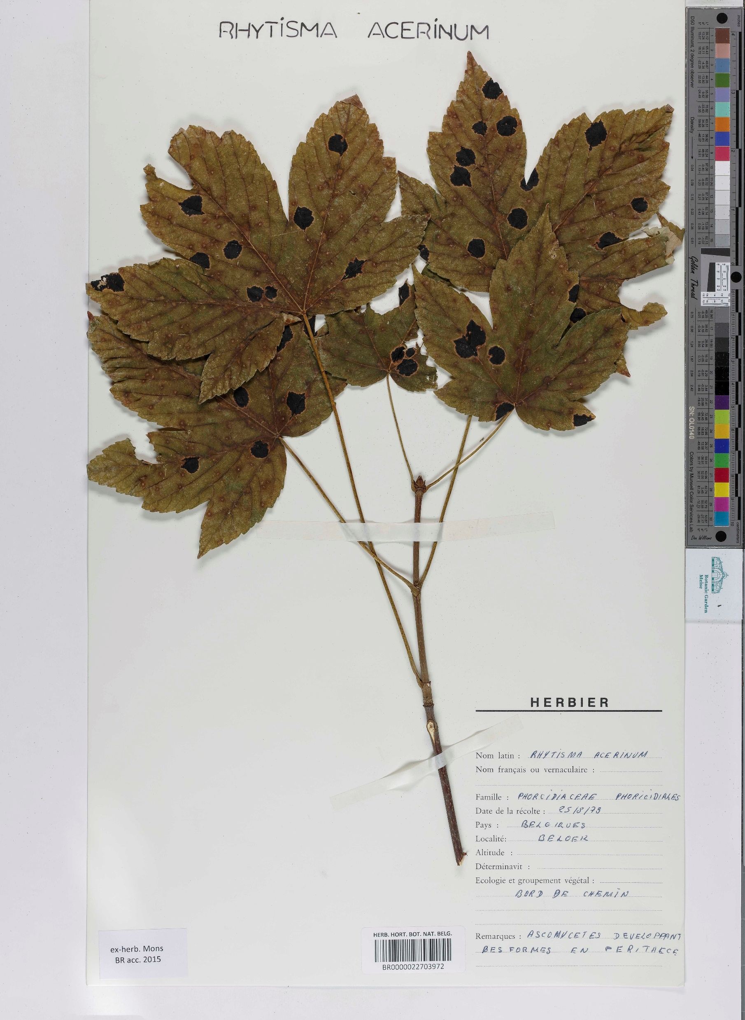
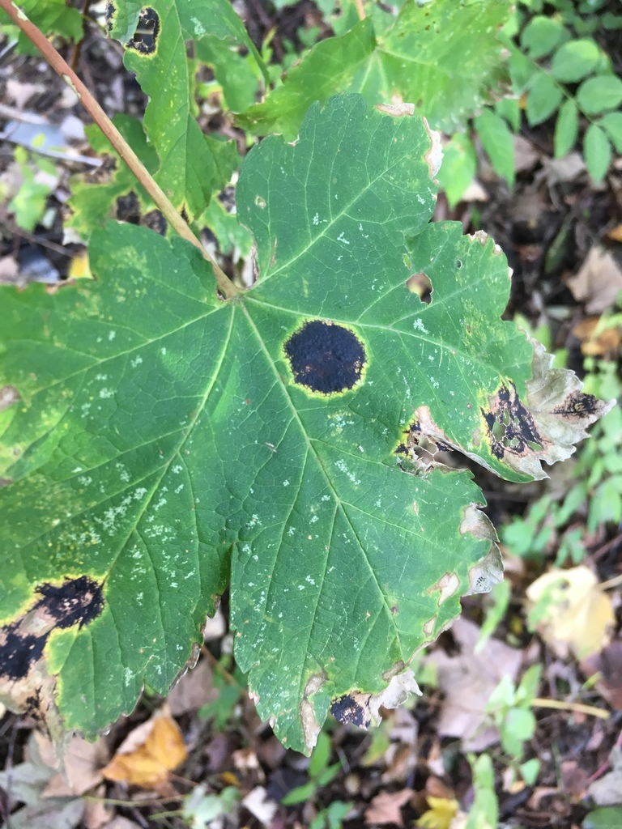
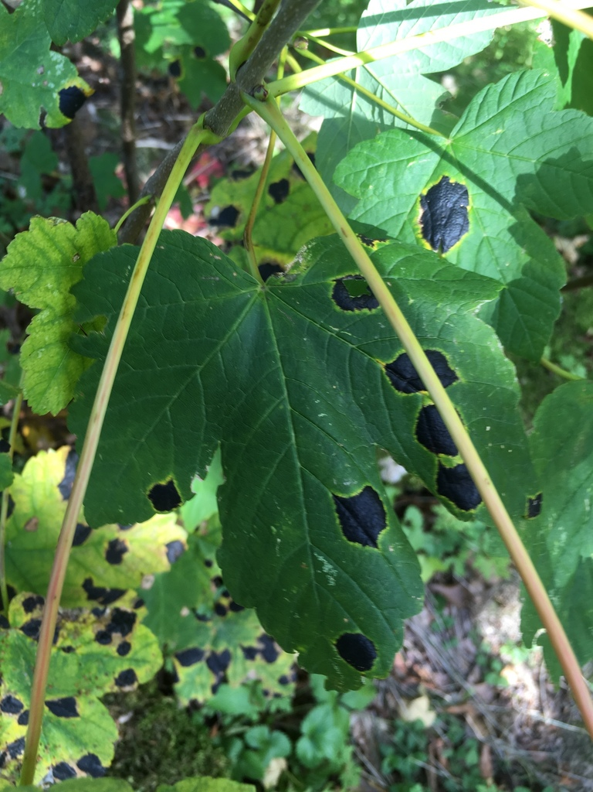

Slide 10






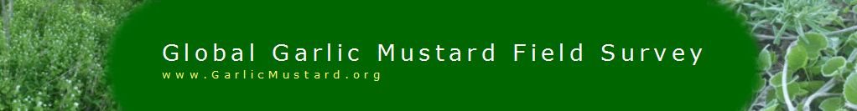
The number of projects and opportunities are growing

Slide 11
Applying Citizen Science Protocols to Digitzed Museum Specimens Enables Data Integration and Discovery

Slide 12








Acknowledgements
Rebecca Forkner
Rebecca Dikow
Lorelei Crerar
Rachel Keuler
Alexandra Duffy
Elizabeth Long
Natalie Feldsine
Megan Napoli
Tedra Cuddy

Slide 13
Questions?

